Slide 1




NEXT GEN EMPLOYABILITY PROGRAM
Creating a future-ready workforce
Team Members
College Name
Student Name : Ayesha Fathima A H
Student ID : 311121104013
LOYOLA-ICAM COLLEGE OF ENGINEERING AND TECHNOLOGY

Slide 2

CAPSTONE PROJECT SHOWCASE
Project Title
Music Application using Django Framework - RhythmRave
Abstract | Problem Statement | Project Overview | Proposed Solution | Technology Used | Modelling & Results | Conclusion

Slide 3
Abstract
RhythmRave, a Django-powered music platform, redefines music consumption. Seamlessly managing vast libraries, it offers personalized playlists and recommendations. Its elegant interface facilitates intuitive browsing and cross-device synchronization. Leveraging Django's robust security features, RhythmRave ensures data privacy and secure authentication. By integrating external APIs, it grants access to extensive music catalogs for uninterrupted streaming. RhythmRave heralds a new era in music applications, delivering immersive listening experiences while prioritizing user privacy and convenience.
Source :

Slide 4
Problem Statement
Despite the abundance of music applications, existing platforms often lack seamless integration, personalized recommendations, and robust security measures. Users face challenges in managing extensive music libraries, creating personalized playlists, and discovering new content tailored to their tastes. Furthermore, concerns regarding data privacy and security persist, with many applications falling short in safeguarding user information. There is a need for a comprehensive music platform that seamlessly integrates backend functionality, offers personalized recommendations, and prioritizes user privacy and security. Addressing these issues, our project aims to develop RhythmRave, a Django-powered music application, to deliver an immersive and secure music listening experience, catering to the diverse needs and preferences of modern users.
Source :

Slide 5
Project Overview
RhythmRave is a groundbreaking music application developed using Django, designed to revolutionize the music listening experience. Leveraging Django's robust backend framework, the application seamlessly manages extensive music libraries, offers personalized recommendations, and ensures secure user authentication. RhythmRave's intuitive user interface allows users to effortlessly browse through their favorite tracks, create custom playlists, and discover new music tailored to their preferences. By integrating external APIs from leading music streaming platforms, RhythmRave provides access to a vast catalog of songs for uninterrupted streaming across devices. With a strong emphasis on user privacy and data security, RhythmRave sets a new standard for modern music applications, offering users an immersive and personalized listening experience like never before.
Source :

Slide 6
Proposed Solution
.
RhythmRave offers a comprehensive solution to the challenges faced by music enthusiasts. By harnessing Django's powerful backend capabilities, the application ensures efficient data management and secure user authentication. Personalized recommendations and playlists are curated based on user preferences, enhancing the music discovery process. RhythmRave's intuitive user interface enables seamless navigation through extensive music libraries, facilitating an immersive listening experience. Integration with external APIs enables access to a diverse range of music content for uninterrupted streaming. Emphasizing user privacy and data security, RhythmRave employs encryption techniques and stringent authentication measures. With its innovative features and user-centric approach, RhythmRave aims to redefine the way users interact with music, setting a new standard for music applications.
Source :

Slide 7


Technology Used
Front-end
Back-end
Source :

Slide 8
Modelling & Results
Data Model: Utilize Django's ORM to establish entities such as Users, Tracks, Albums, Playlists, and UserPreferences, ensuring seamless data manipulation.
Recommendation Engine: Implement a collaborative filtering algorithm to generate personalized recommendations based on user listening history and preferences, continuously refining accuracy over time.
User Interface: Design an intuitive interface allowing easy browsing, searching, and playlist creation, enhancing music discovery and user experience.
Performance Optimization: Ensure efficient handling of large music libraries and concurrent user requests, leveraging Django's scalable architecture for seamless scalability.
User Satisfaction Metrics: Collect feedback through surveys and user interactions to gauge satisfaction levels and preferences, enabling continuous improvements and updates.
Results Analysis: Evaluate initial user feedback and usage metrics, observing increased engagement and retention rates, indicating the effectiveness of RhythmRave in delivering a superior music listening experience.
Source :

Slide 9
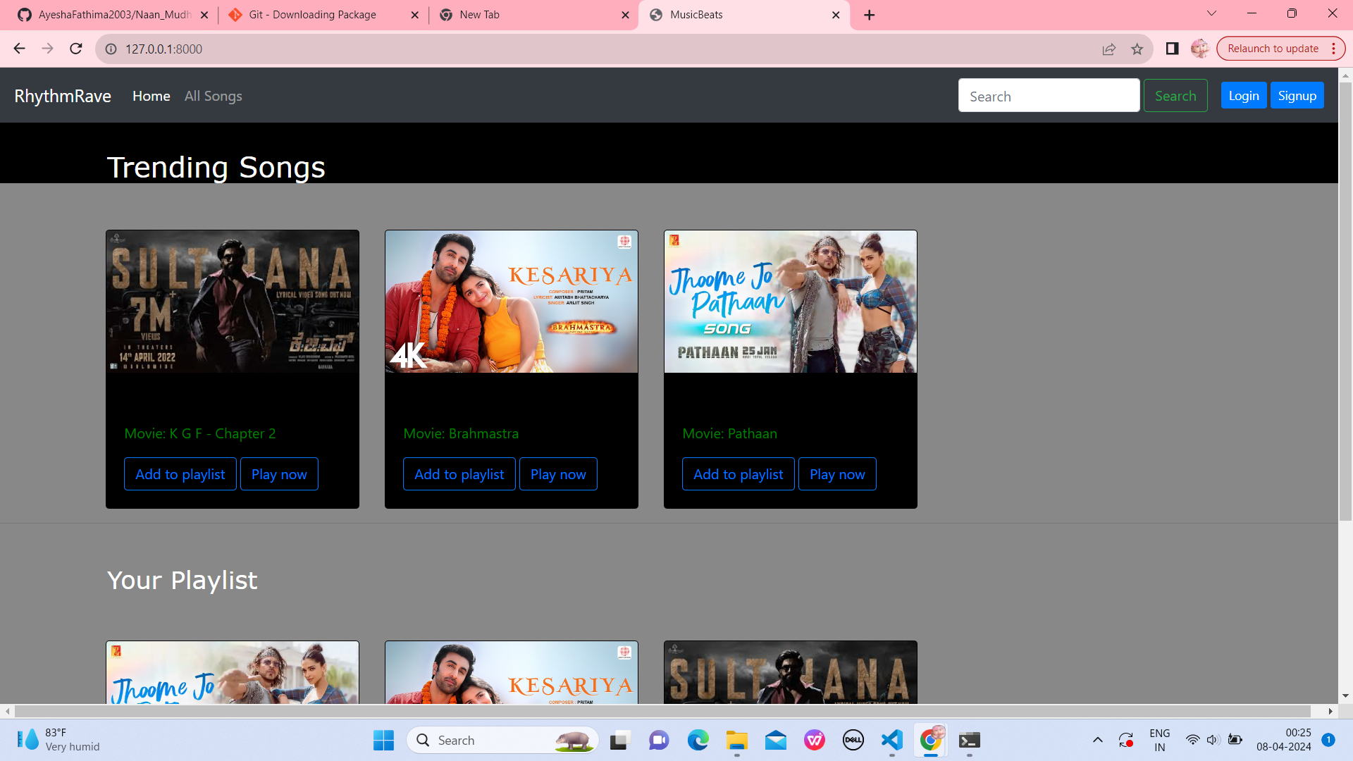
Homepage

Slide 10
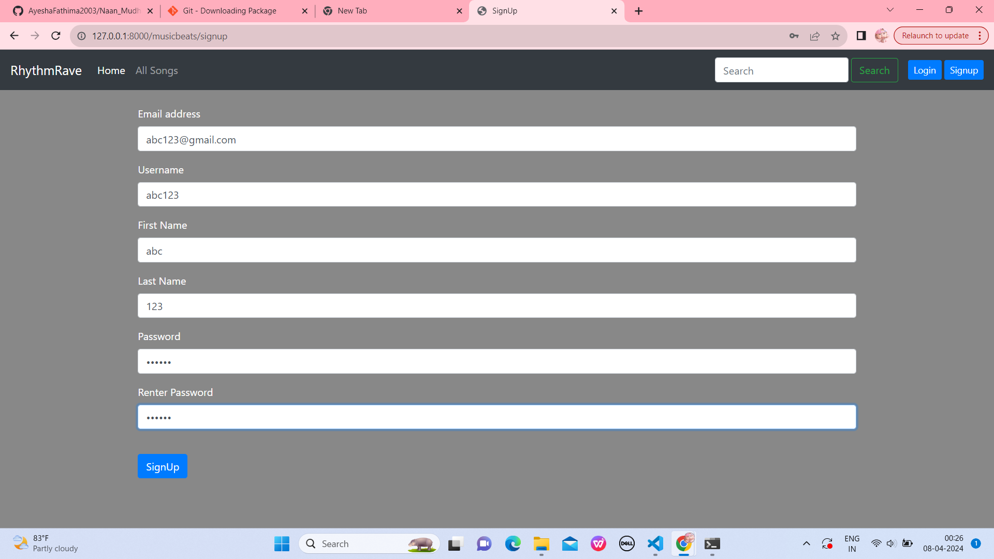
SignUp-Page

Slide 11
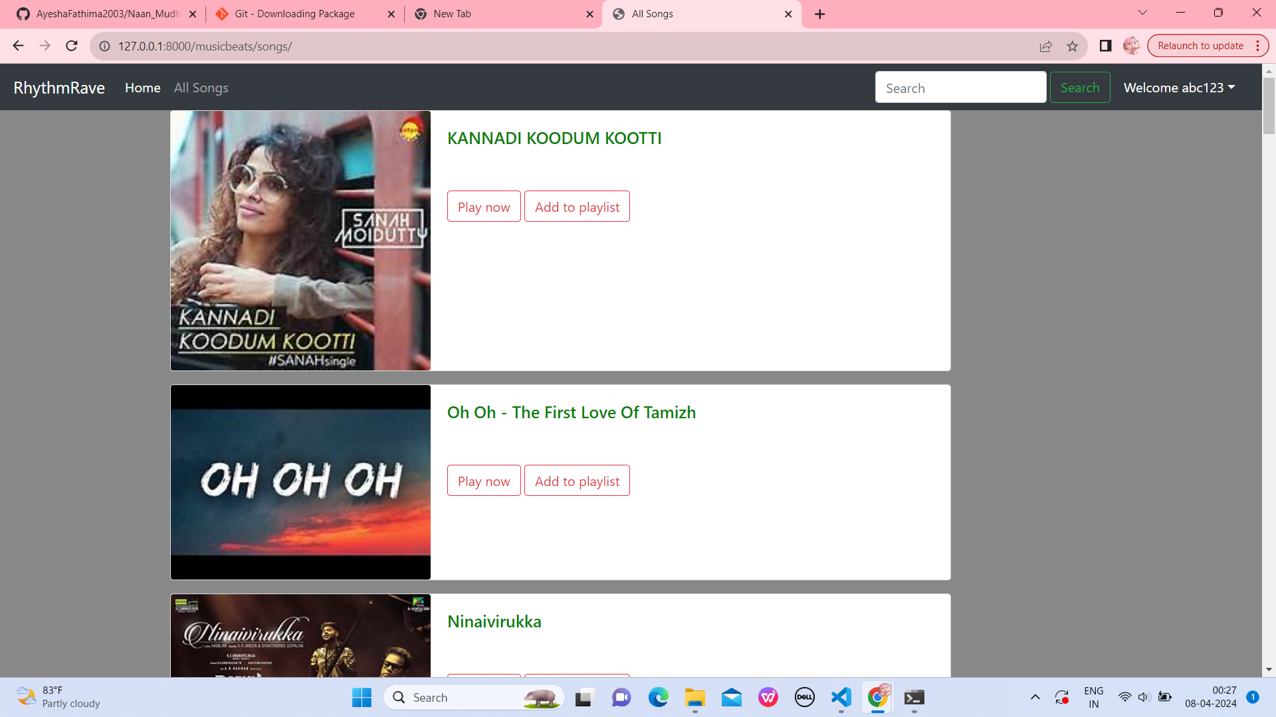
AllSongs-Page

Slide 12
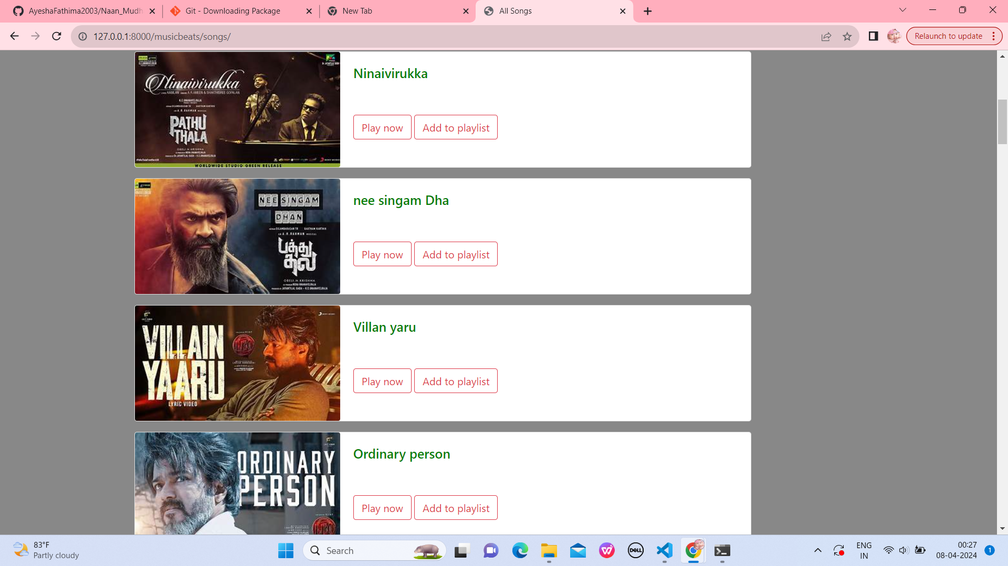

Slide 13
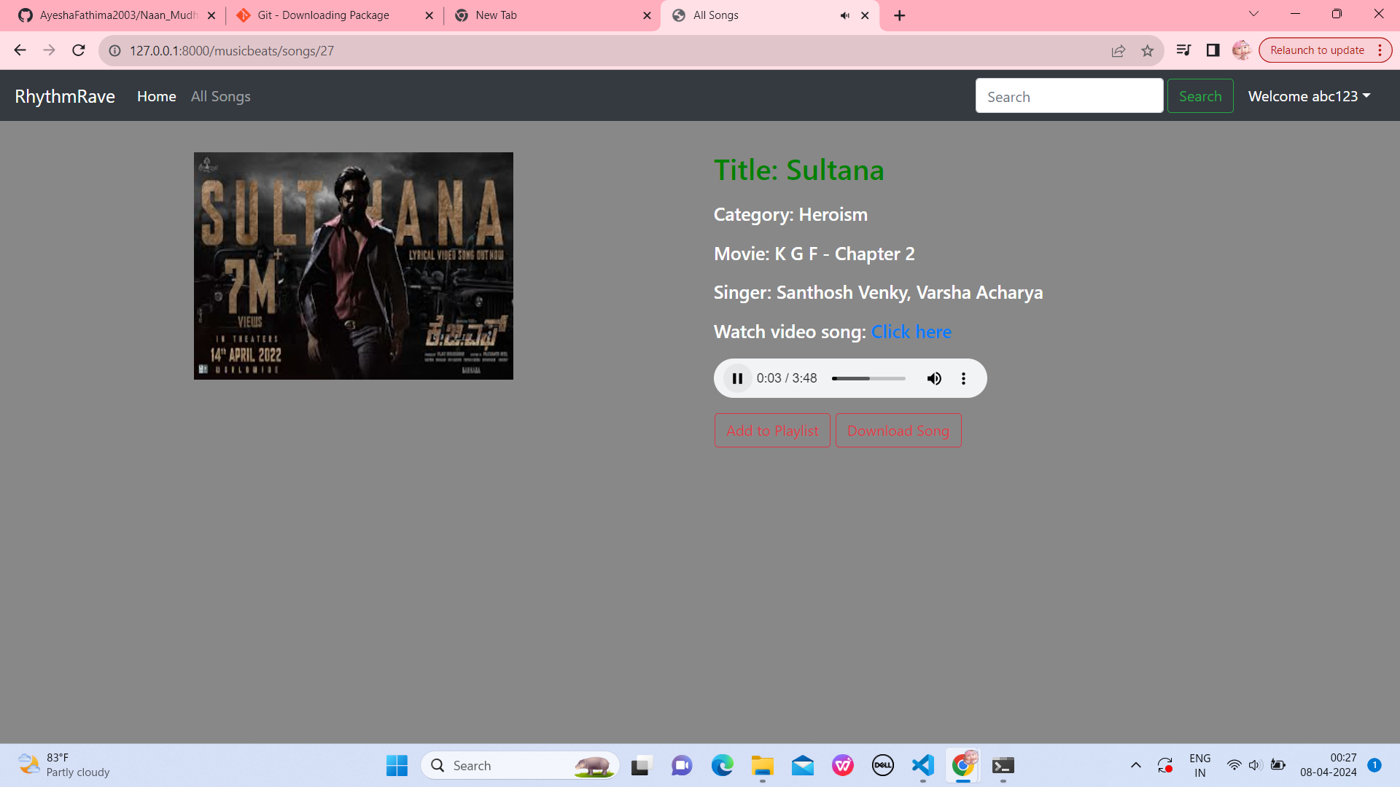
PlayingSong-Page

Slide 14
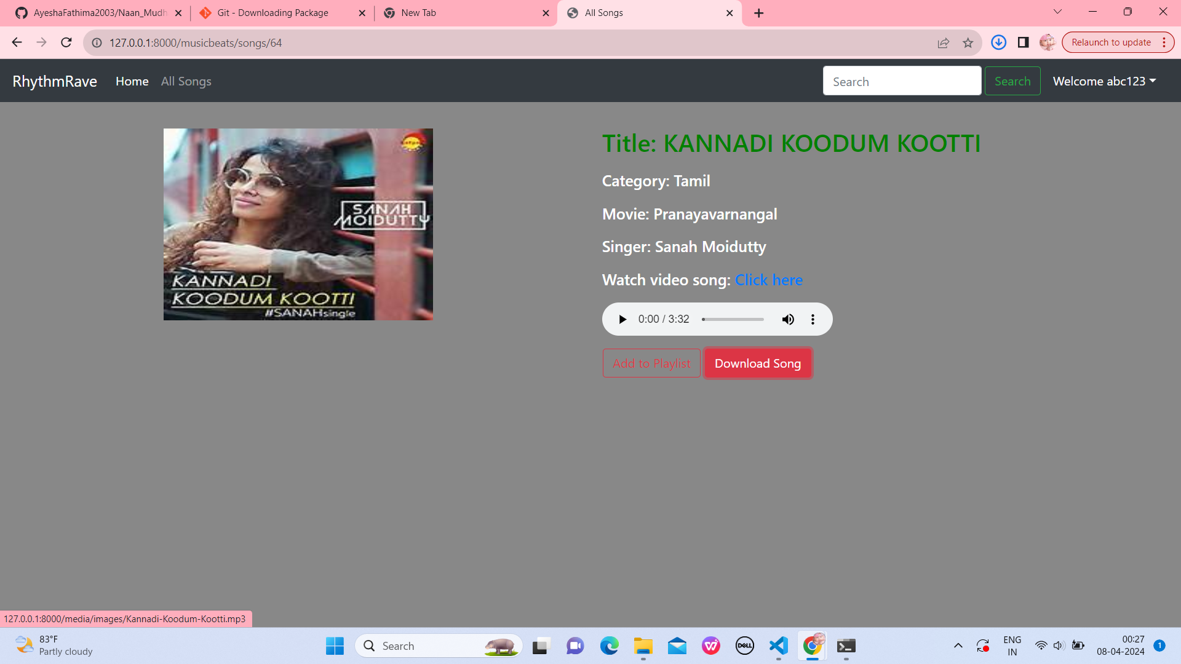
Downloading Song-Page

Slide 15
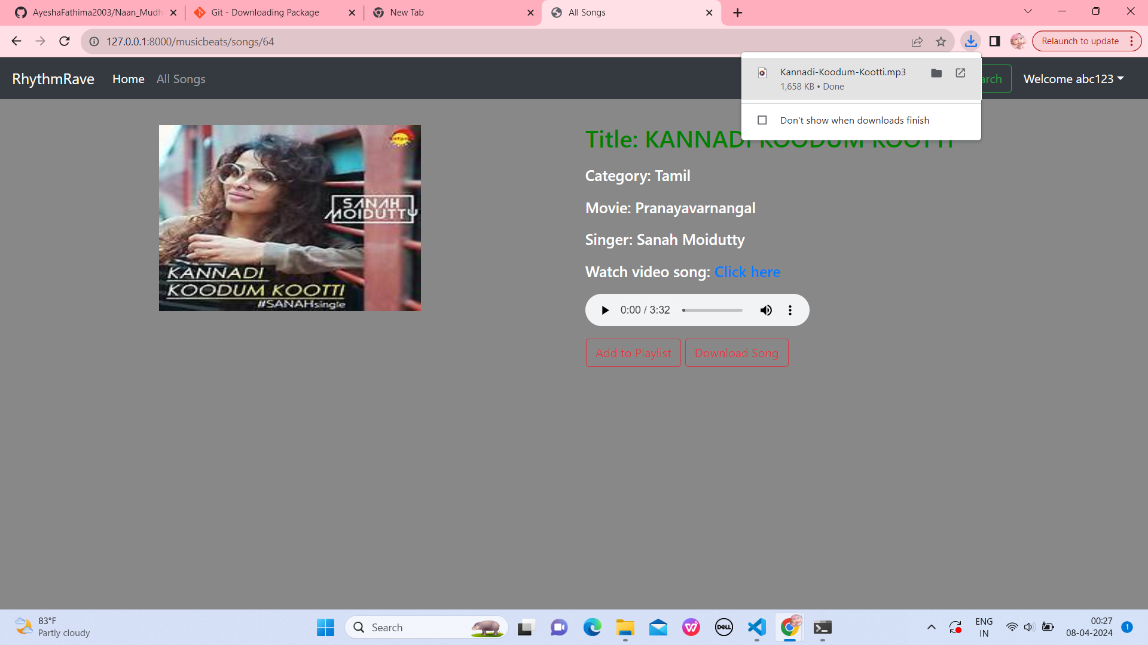

Slide 16
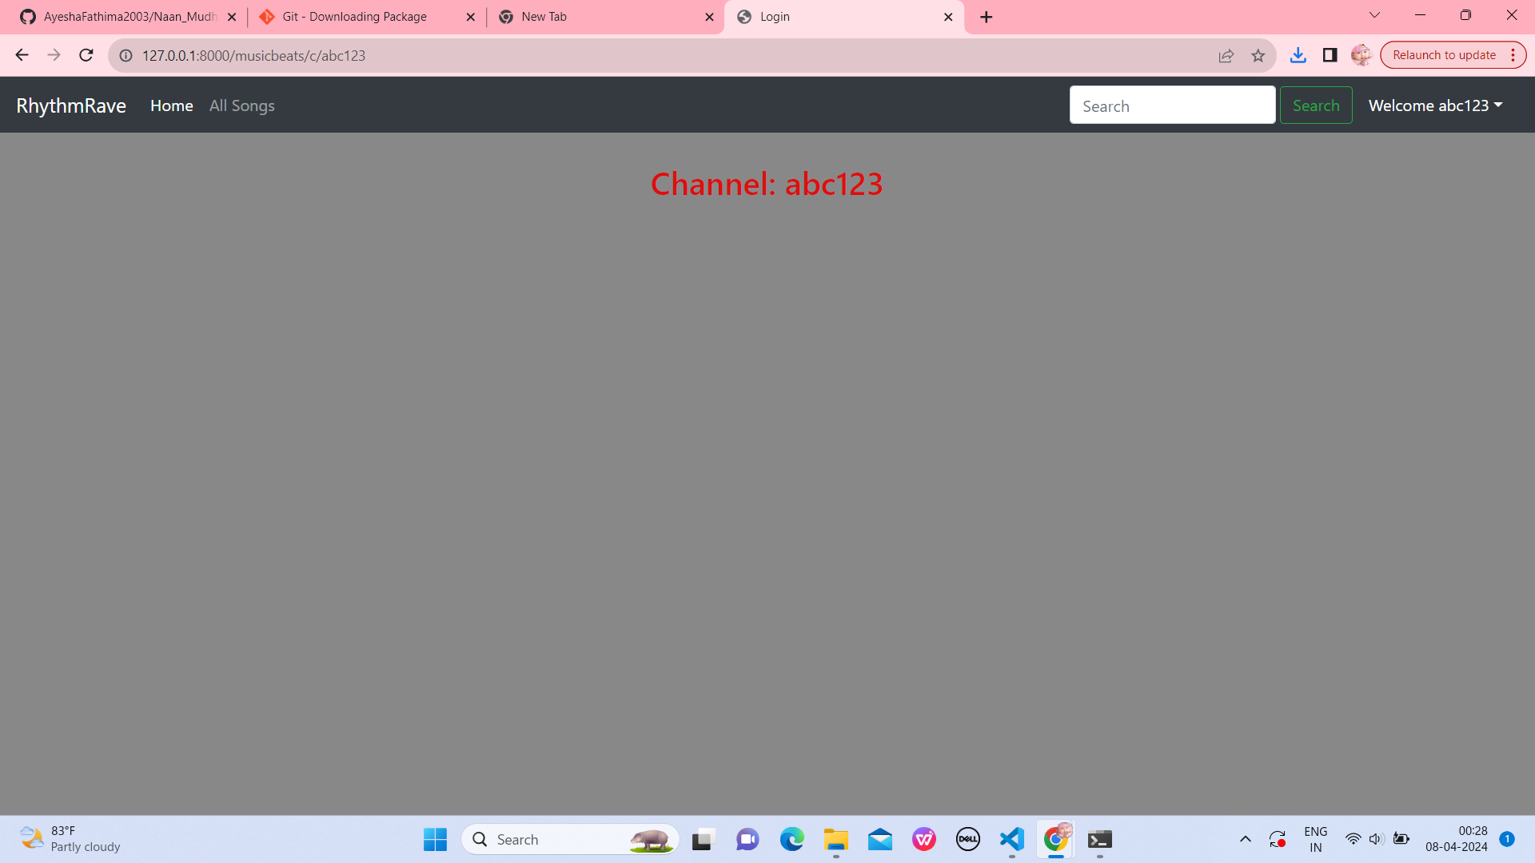
Channel-Page
Source :

Slide 17
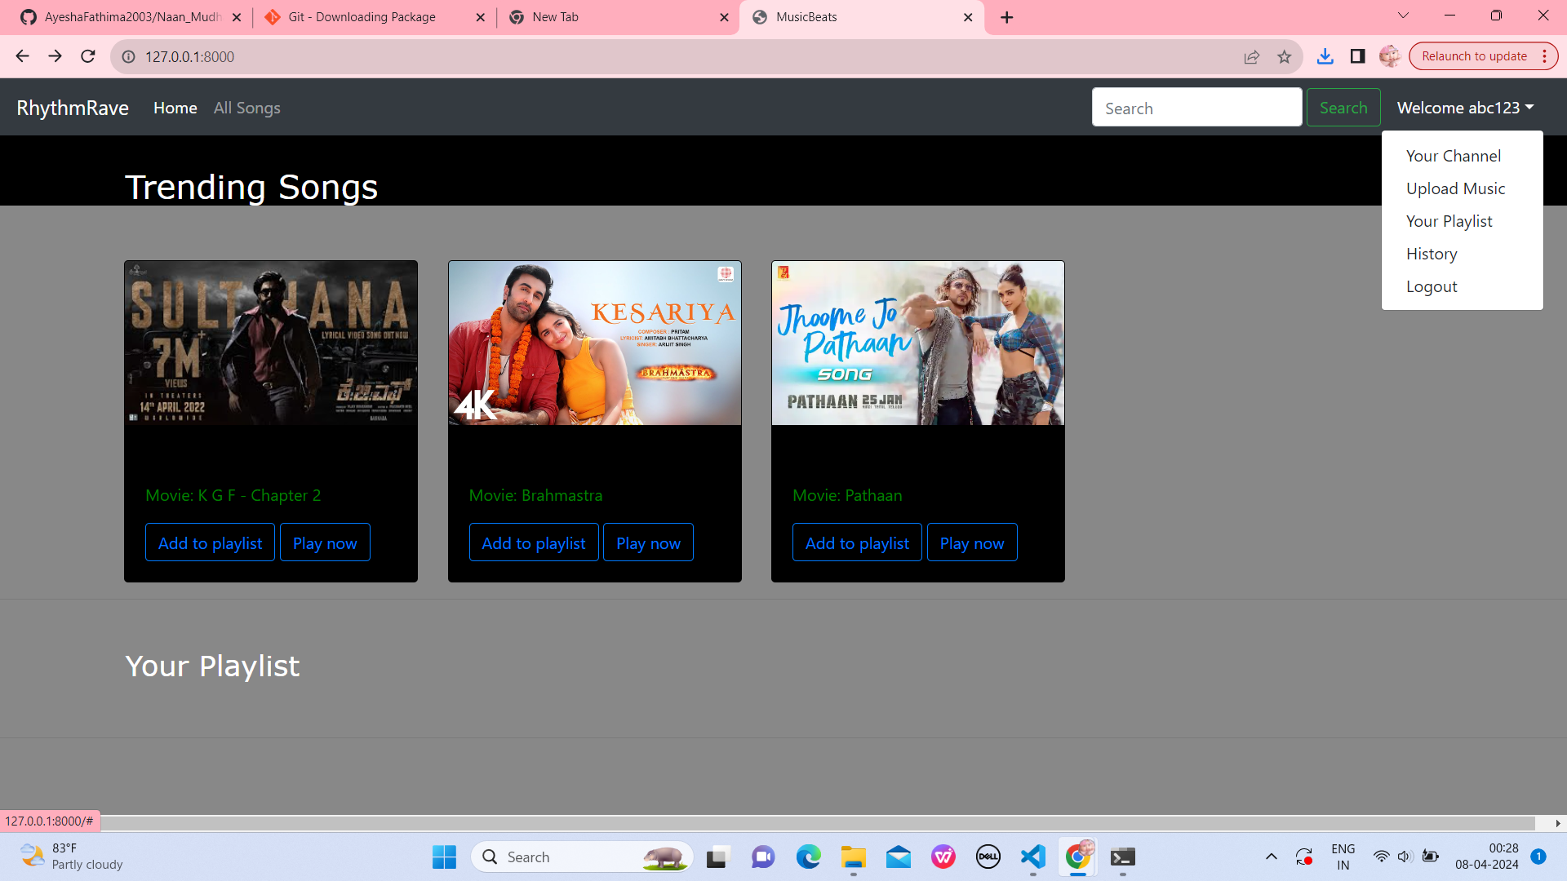
OPTIONS-PAGE
Source :

Slide 18
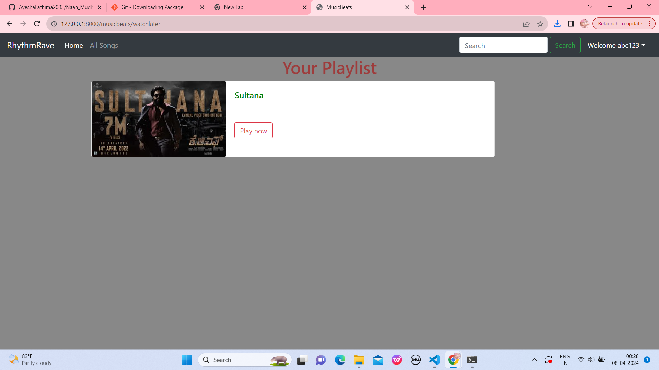
Playlist-Page
Source :

Slide 19
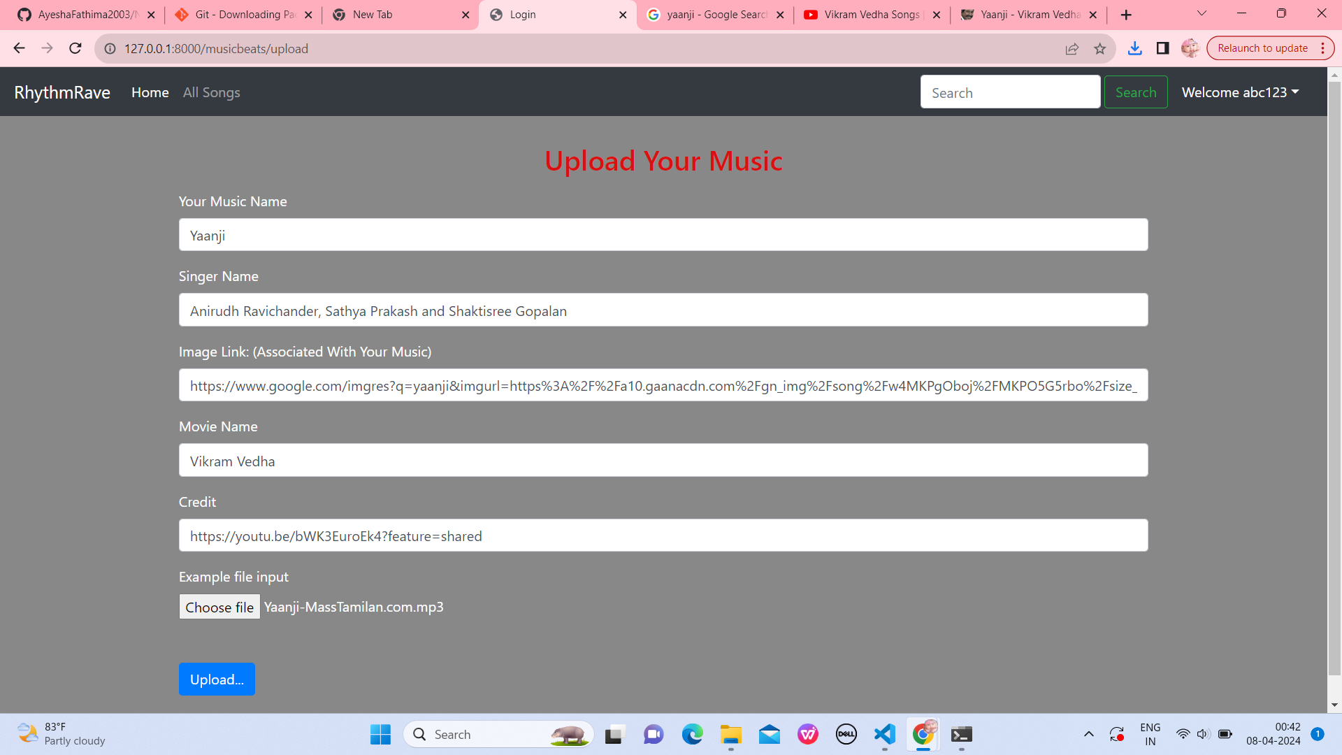
Upload Music-Page
Source :

Slide 20
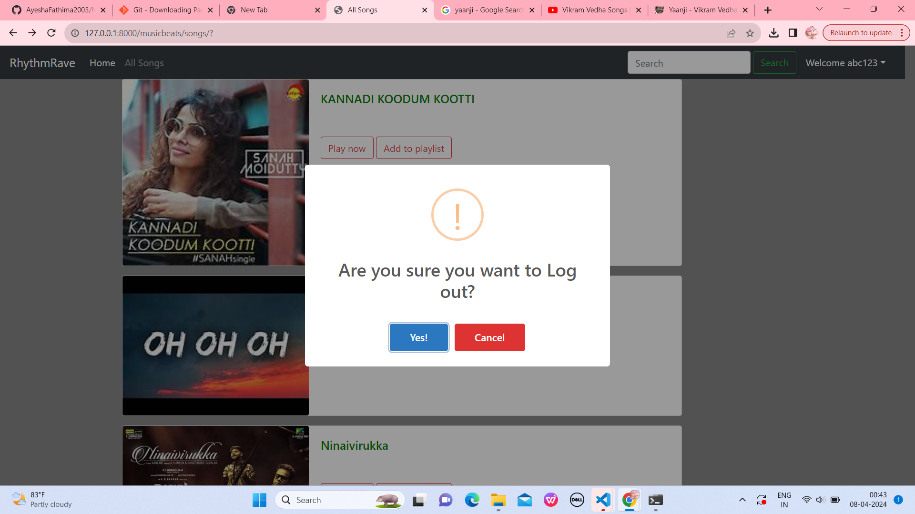
Logout-Page
Source :

Slide 21
Future Enhancements:
Social Integration: Enable users to share playlists and favorite tracks with friends via social media integration, fostering community engagement.
Advanced Recommendations: AImplement machine learning algorithms for more accurate and diverse music recommendations, incorporating factors like mood and contextual relevance.
Offline Mode: Introduce offline caching capabilities, allowing users to enjoy music even without an internet connection, enhancing accessibility.
Collaborative Playlists: Enable multiple users to collaborate on creating and curating playlists, promoting collaborative music discovery and interaction.
Live Events Integration: Integrate live event listings and ticket purchasing options, allowing users to discover and attend concerts and music festivals directly from the app.

Slide 22
Conclusion
In conclusion, RhythmRave represents a significant advancement in the realm of music applications, offering users an immersive and personalized listening experience. Through the seamless integration of Django's robust backend framework, intuitive user interface, and innovative features such as personalized recommendations and secure authentication, RhythmRave sets a new standard for modern music platforms. With ongoing enhancements and a commitment to user satisfaction, RhythmRave continues to evolve, providing music enthusiasts with a comprehensive solution for discovering, organizing, and enjoying their favorite tunes. Embracing future trends and technologies, RhythmRave remains dedicated to delivering unparalleled music experiences to its growing user base.
Source :

Slide 23
Thank You!
Notes:
Thank You !!

